Slide 1


HEART ANALYSIS
Surya V
13-02-2025
Data analytics & Data science
Oct 2024

Slide 2
PROJECT OVERVIEW
OBJECTIVE:
The Objective of the Project is to analyze patient data to identify trends, risk factor and correlations associated with heart disease.
METHODOLOGY &APPROACH:
Generate the dataset using Mackaroo
Analyze the dataset
Creating dashboard
Creating story
Insights & Conclusion

Slide 3
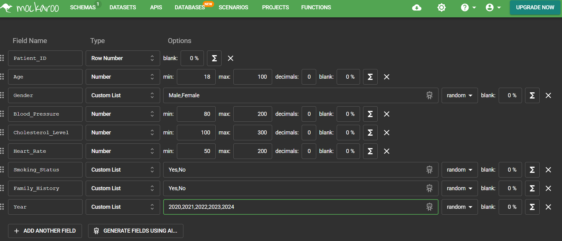
Dataset Description
Data Source:
Generated the dataset using Mockaroo.
Data includes 1000 rows of patient records.
Key Features:
Patient details (Age, Gender, State).
Health metrics (Blood Pressure, Cholesterol, Heart Rate, BMI).
Lifestyle factors (Smoking, Family History).
Diagnosis Rate and Heart Disease Status.

Slide 4
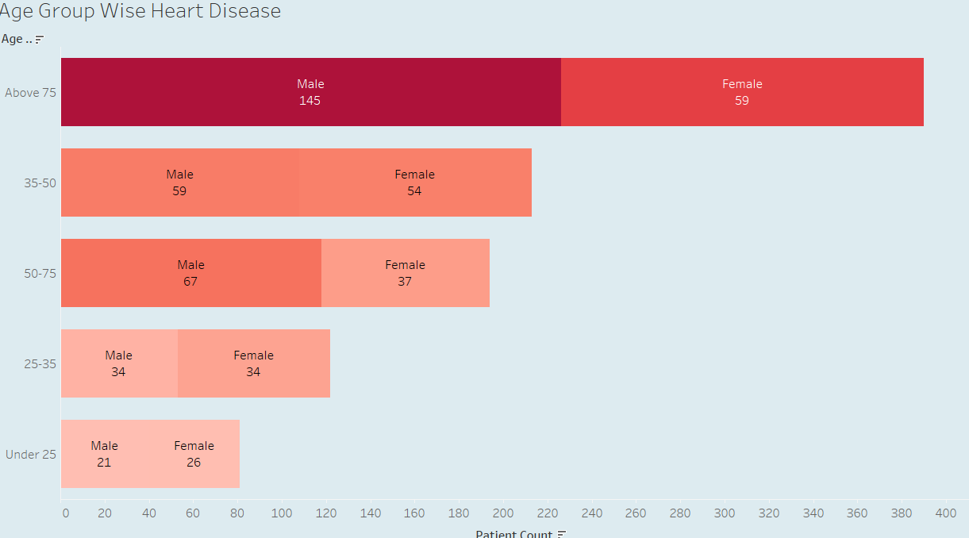
Visualizations & Trends
Heart disease increases with age, peaking in those above 75 (Males: 145, Females: 59).
Men have more cases than women in most age groups, especially 50+.
25-35 age group is balanced (Males: 34, Females: 34).
Under 25 has the fewest cases, with slightly more in females

Slide 5
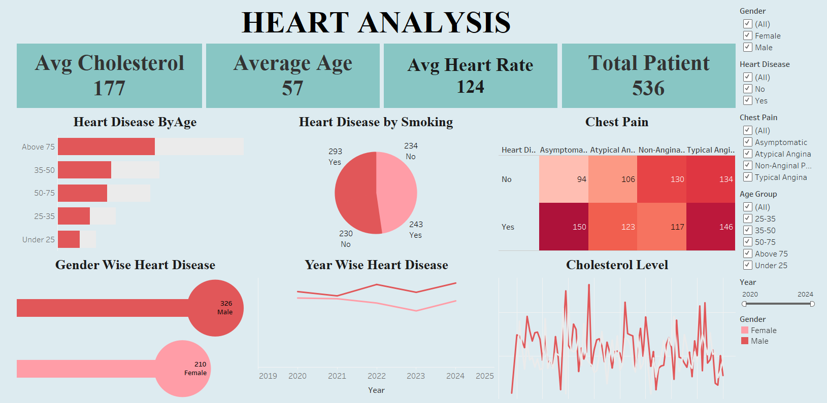
DASHBOARD

Slide 6
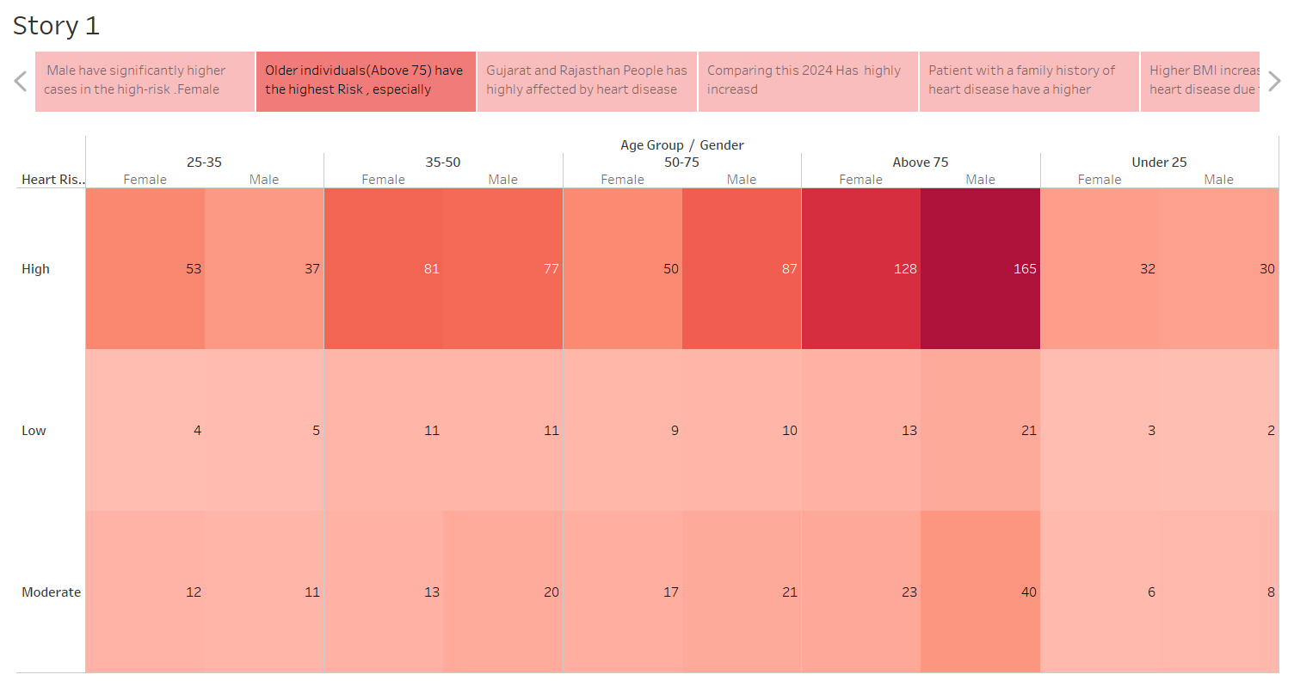
STORY

Slide 7
INSIGHTS:
Heart Disease risk increases with age.
Male-326, Female-210.
High Cholesterol Level –High Risk.
Chest Pain- Symptomatic, Typical-Angina.
Major Contributor –Smoking , BMI.

Slide 8
INSIGHTS:
Older individuals, especially above 50, shows a high diagnosis rate.
Blood Pressure & Cholesterol – High levels significantly increase the likelihood of heart complications.
Smokers show a higher incidence of heart disease compared to non-smokers.
Patients with a family history of heart disease are more prone to developing it.
Patients with a BMI over 100 tend to have higher cholesterol
Men generally have a higher risk of heart disease compared to women.

Slide 9
.
Recommendation:
Monitor blood pressure and cholesterol levels regularly.
Maintain a healthy BMI through diet and exercise.
Avoid smoking to reduce heart disease risk.
Manage stress and ensure adequate sleep.
Get regular Heart health checkups , especially with a family history.
Get regular screenings if you have diabetes or hypertension

Slide 10
Thank You

